Slide 1
“It’s about getting things down to one number. Using the stats the way we read them, we’ll find value in players that no one else can see.” – Peter Brand
Craig J. Stiles
craig@decidere.com

Slide 2
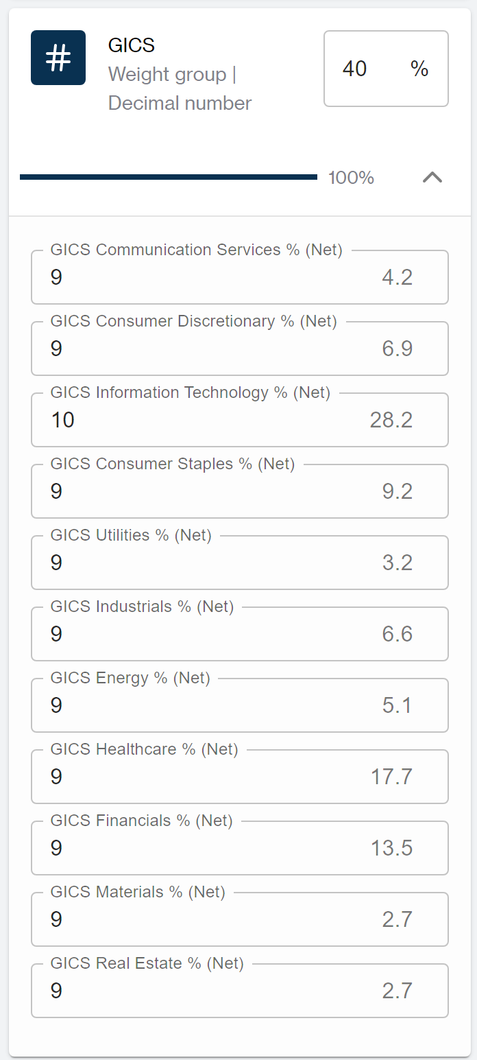
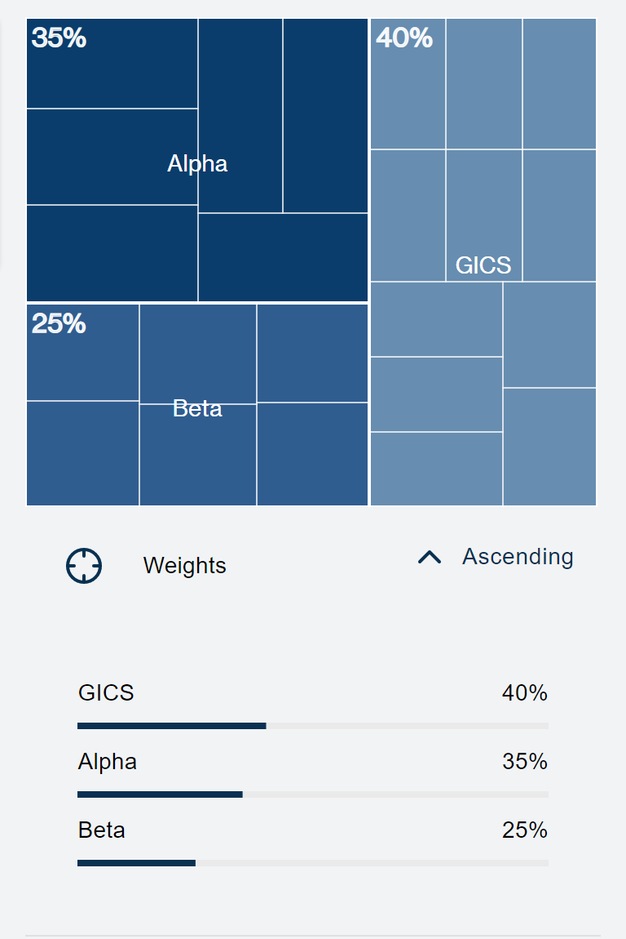
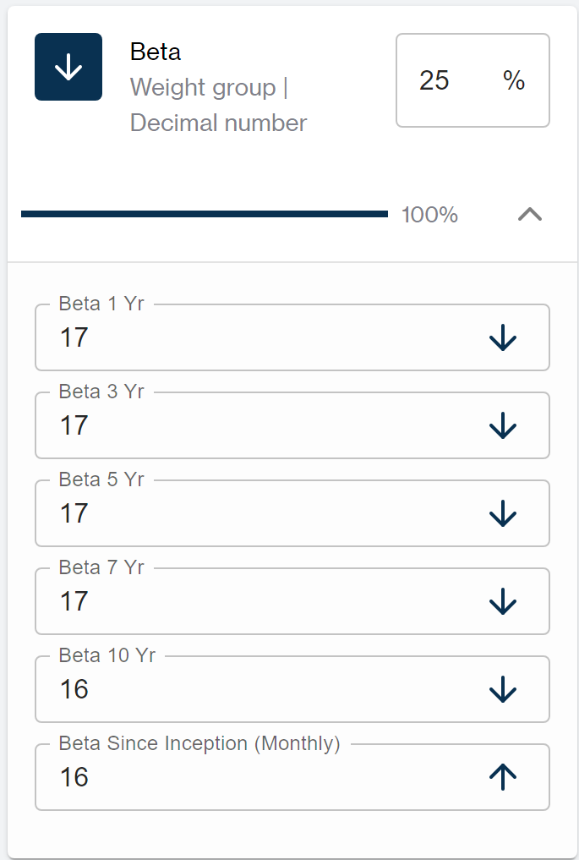
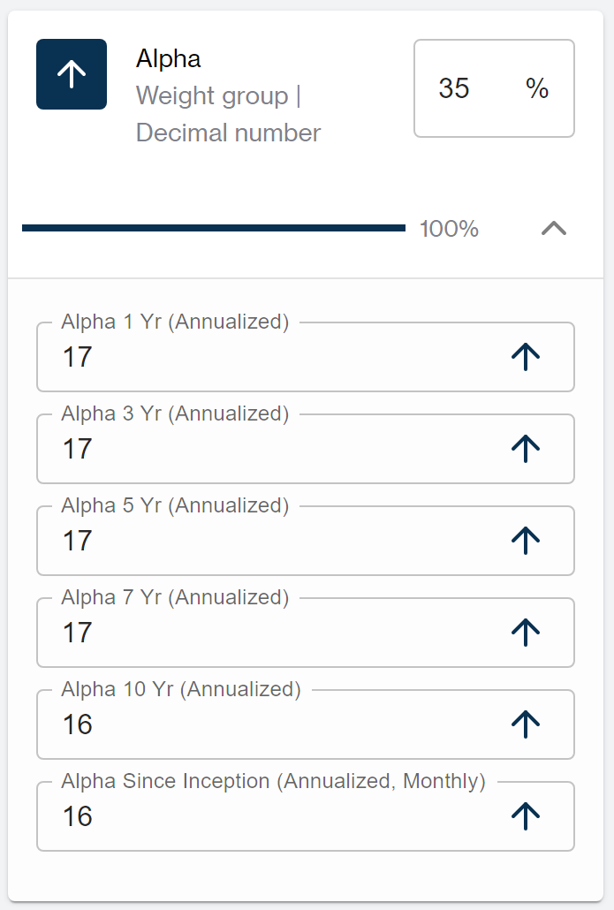
Empower Financial Decisions with Precision Analytics.
Decidere is a go-to web application for powerful and responsive financial analytics. Our easy-to-use platform provides a wealth of data-driven insights to make informed decisions and drive financial success. Whether you're a financial advisor, institutional investor, or simply looking to better manage your personal finances, Decidere offers a range of customizable data analytics solutions to suit your needs.

Slide 3
PROBLEM
Increasing need to reduce planning and budgeting cycles, the proliferation of big data and advanced analytics across financial operations, the increasing adoption of predictive analytics across industries, the need for better management of risk and compliance issues, and the catalyzed investments in the fintech industry.
MARKET GAP
B-B, or B-C, opportunities where the institution, or individual, have their own custom data, or purchased data, need an effective and efficient way to present results quickly in a repeatable format.
CUSTOMERS
According to various sources, the global financial analytics market size was valued at around $10 billion in 2020 and is projected to reach $25 billion by 2028, growing at a CAGR of 11.5%
FINANCIALS
COSTS
Loss of time due to ineffective and inefficient product search solutions while filtering technology has not changed for decades, resulting in loss of potential opportunities.

Slide 4
SOLUTION
CLOSE THE GAP
TARGET AUDIENCE
Aggregate datasets across multiple investment platforms creating consistent and repeatable searching capabilities, efficiently and effectively reducing risk and compliance issues
Asset Managers, Financial Firm Research Departments, Financial Advisors, and DIY Investors
COST SAVINGS
EASY TO USE
Product search time reduced, production velocity increased, product management costs reduced, increase capacity of analysts, reduction of analytic tools into one process for all products, ability to only pay for what you need.
Create and Name Scenario, Select Criteria for Scenario, Determine Importance of Criteria, Determine Dataset on which to Apply Scenario, Review Results. Repeat.

Slide 5
PRODUCT OVERVIEW
UNIQUE
Effectively and efficiently applying Sabermetrics to the financial industry creating the ability to build a portfolio with a client during a single meeting
FIRST TO MARKET
First product to effectively and efficiently apply Sabermetrics to financial industry for B-B and B-C opportunities, allowing end user to control cost and process
TESTED
Concept used in financial practice for nearly 20 years. Evolved to web-based product that can be easily commoditized and client facing
AUTHENTIC
Initially designed for the financial industry, concept is being explored for use in other industries to include: Real-estate, automotive, RV, Sports, etc.

Slide 6
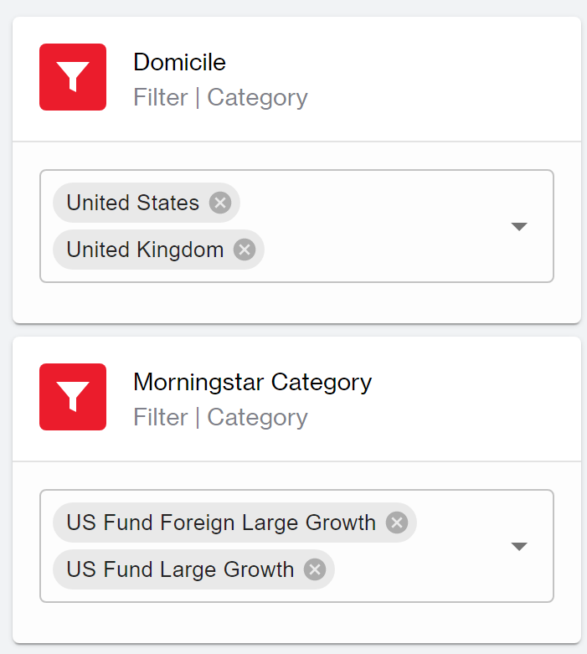
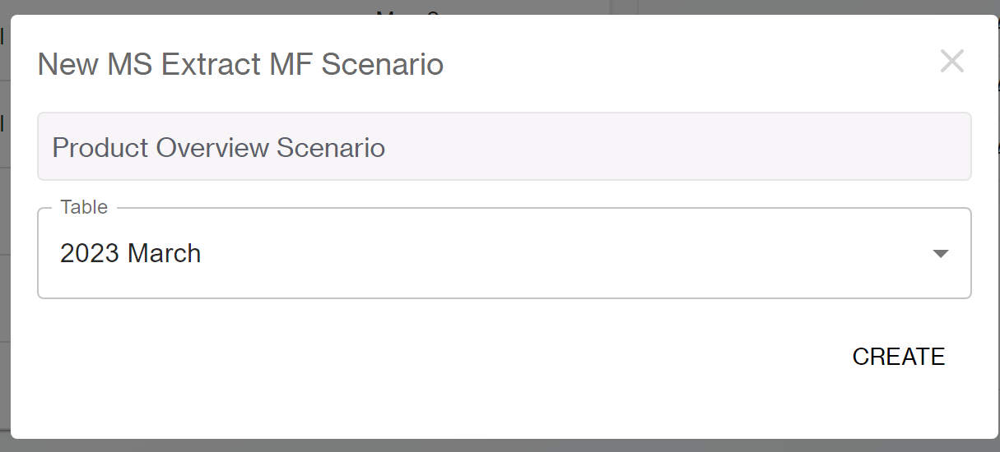
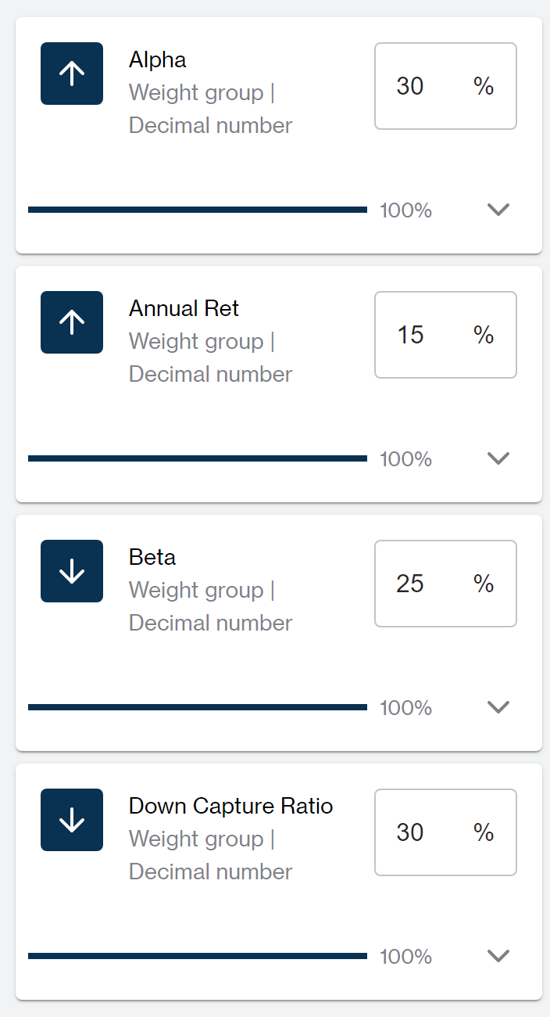
PRODUCT Overview Cont.
Create Scenario
Apply to Dataset
Select Criteria/Determine Importance
Review Results

Slide 7
SUMMARY
Most of the time, products that may be most appropriate for clients get “filtered out” early in the process due to one data point in one criteria which may, or may not, be important to a client. Our process eliminates that potential and creates the ability for a firm to offer a consistent advisory process starting at their research department, ending with the advisors’ product recommendations offered through the firm; aligning more closely the clients' goals and meeting compliance and regulatory risk concerns affirming the products recommended are selected with the clients’ best interests in mind.

